Slide 1
Course: Advanced Natural Language Processing (NLP)
Instructor: Dr. Atif Khan

Slide 2
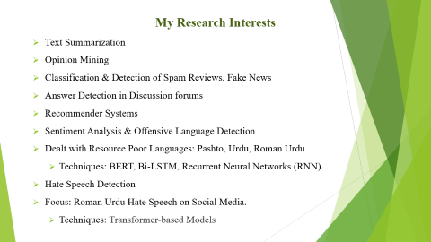

My Research Interests
Text Summarization
Opinion Mining
Classification & Detection of Spam Reviews, Fake News
Answer Detection in Discussion forums
Recommender Systems
Sentiment Analysis & Offensive Language Detection
Dealt with Resource Poor Languages: Pashto, Urdu, Roman Urdu.
Techniques: BERT, Bi-LSTM, Recurrent Neural Networks (RNN).
Hate Speech Detection
Focus: Roman Urdu Hate Speech on Social Media.
Techniques: Transformer-based Models

Slide 3
What is NLP
Natural language processing (NLP) is the ability of a computer program to understand human language as it's spoken and written -- referred to as natural language. It's a component of artificial intelligence.
OR
Natural language processing is a subfield of linguistics, Computer Science and Artificial Intelligence, concerned with interactions between computers and human language (natural languages), in particular how to program computers to process and analyze large amount of natural language data.

Slide 4
What is NLP

Slide 5
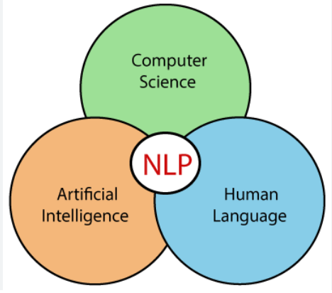
What is NLP
NLP is a combination of three fields:
Linguistics: Study of languages
Computer Science: Technology and programming
Artificial Intelligence: Machine learning and intelligence
Goal of NLP: Enable machines to understand and process natural language
Machines should:
Understand spoken and written language
Interact effectively with humans by listening, comprehending, and responding in natural language

Slide 6
Need for NLP
Definition of natural language from Wikipedia, which states that natural language refers to any language used naturally by humans for communication without planning or formal instruction.
It distinguishes natural languages from constructed ones, like programming languages, which are artificial.

Slide 7
Need for NLP
Evolution of Human Progress
Early Human Existence
Ancestors lived similar lives to other animals.
Resided in jungles and led simple, animal-like lives.
Advancement Over Time
Humans have progressed to space travel.
Contrast with other animals, which remain unchanged.
Critical Factors for Advancement:
Communication and Language
Machines

Slide 8
Need for NLP
Communication and Language
Enabled sharing of ideas and knowledge.
Teachers transmitted knowledge to future generations.
Building upon past knowledge drove progress.
Impact of Communication
Essential for human development and advancement.
Growth in language and communication played a key role in progress.

Slide 9
Need for NLP
Accelerating Human Growth
Industrial Revolution
Began 300-400 years ago.
Major factor in accelerating human growth and development.
Impact of Machines
Machines played a crucial role in rapid development.
Led to significant technological and societal advancements.
Role of the Internet
Further propelled progress alongside machines.
Expanded communication and information access.
Future Milestone
The next significant milestone: seamless communication with machines.
Potential to revolutionize human-machine interaction and development.
Notes:
Seamless Communication: This refers to the ability to interact with machines as effortlessly as we do with other humans. It means that machines will understand and respond to us in a natural and intuitive way, without requiring special commands or programming knowledge.
Potential Impact: Achieving this milestone could dramatically transform how we interact with technology. It could make complex tasks easier, enhance productivity, and create new opportunities for innovation. For example, asking a machine for help could be as simple as having a conversation with a person, making technology more accessible and user-friendly.

Slide 10
Need for NLP
Current State of Human-Machine Interaction
Challenges in Communication
Talking to machines is not yet easy or intuitive.
Early interactions involved mechanical tools.
Progressed to electronics and then computer science for programming.
Complexity of Programming
Programming machines requires specialized skills.
Not everyone can easily program or operate machines.
Current Interaction Limitations
Operating devices like smartphones requires physical commands or gestures.
Interaction is not yet as seamless or intuitive as desired.

Slide 11
Need for NLP
Future Vision: Effortless Communication
Imagine interacting with machines as easily as with humans.
Potential for significant advancement in how we communicate with technology.
Example Scenario
ATM interface: Person could ask the machine for help and receive instructions.
Future goal: Machines respond and interact as naturally as humans do.
Next Frontier in Growth
Achieving natural communication with machines.
Could greatly enhance user involvement and accelerate technological development.

Slide 12
Need for NLP
Progress in Human-Machine Communication
Examples of Progress
Technologies like Google Assistant, Alexa, and Siri are examples of efforts to enable communication with machines.
Progress is evident, but full seamless interaction is not yet achieved.
Work in Progress
Current developments in human-machine communication are promising but still require further advancements.
Ongoing improvements are necessary for more natural interactions.
Role of NLP (Natural Language Processing)
NLP is the key technology that will enable smooth, human-like communication with machines.
Once fully developed, NLP has the potential to revolutionize human interaction with technology.
Investment in NLP
Companies are heavily investing in NLP to advance the field.
The race is on to be the first to achieve significant breakthroughs in this area.

Slide 13
Real world Applications of NLP in Use
Current NLP Applications:
Companies are already integrating NLP into products delivered to customers.
Becoming an NLP Engineer:
To become an NLP engineer, you need to perform 10-12 key NLP tasks.
Familiarity with these tasks is essential for building NLP applications.
Examples of Common NLP Applications:
Chatbots, Siri, and Cortana are widely known NLP applications.
Broader Perspective:
The presentation will showcase different NLP apps to broaden your understanding beyond common examples.

Slide 14
Real world Applications of NLP in Use
Contextual Advertisements
Email Clients – Spam filtering, Smart Reply
Social Media- removing adult content, Opining Mining
Search Engines
Chatbots

Slide 15
Contextual Advertising Powered by NLP
• Traditional Advertising:
Past Approach: Advertisements were uniform and broadcasted to everyone across a region or country.
Example: During TV matches, the same ads were shown to all viewers in PAK, hoping that the broad reach would eventually lead to sales.
• Personalized Advertising Today:
Advancements: With the advent of NLP, companies can now analyze individual behavior to tailor advertisements.
Customization: Ads are personalized based on a user’s specific interests, as identified through their online activity.
• Targeted Ads:
Platform Analysis: Ads on social media platforms like Facebook and Instagram are customized according to users' profiles, posts, and comments.
Interest-Based Ads: For example, users who frequently engage with sports content may see more sports-related ads, while those interested in cosmetics will see ads for beauty products.

Slide 16
Contextual Advertising Powered by NLP
Perception of Being Tracked:
User Experience: Users might feel that their activities are being closely monitored, especially when ads related to recent conversations or searches appear.
Example: Discussing a topic on WhatsApp and then seeing related ads on other platforms can create a sense of being tracked.
NLP-Driven Targeting:
Underlying Science: This process is known as targeted advertising, which uses NLP techniques to analyze and understand user behavior for more effective ad placement.
Impact: NLP enhances the relevance of ads, leading to better user engagement and more efficient advertising strategies.

Slide 17
NLP Applications in Gmail
Spam Filtering:
Automatic Categorization: Gmail uses NLP algorithms to analyze the content of incoming emails and automatically categorize them as spam or non-spam.
Purpose: Helps keep the inbox clean by filtering out unwanted or irrelevant emails.
Smart Replies:
Contextual Suggestions: Gmail’s Smart Reply feature uses NLP to generate suggested responses based on the context and content of the email you receive.
Efficiency: Allows for quick and relevant replies, improving email management and communication efficiency.
Notes:
Streamlines email communication by allowing users to reply with minimal effort, improving response speed and overall productivity.

Slide 18
NLP in Social Media Content Moderation
Challenge:
Inappropriate Content: Social media platforms face challenges in managing inappropriate or harmful content due to large user bases.
Types of Content: Includes hate speech, offensive material, and other forms of inappropriate content.
Role of NLP:
Content Filtering: NLP algorithms analyze and filter content to identify and block inappropriate material.
Hate Speech Detection: Specific NLP techniques are used to detect and remove hate speech and other harmful language.
Objective:
Platform Safety: Ensures that users are exposed to a safer and more respectful online environment by automatically moderating content.

Slide 19
NLP in Sentiment Analysis
Purpose:
Gauge Public Opinion: Sentiment analysis assesses the mood and opinions of the public on various topics.
Application:
Elections: During elections, NLP analyzes social media platforms to predict election outcomes based on the sentiment expressed by users.
Example:
Twitter Analysis: By evaluating tweets and online discussions, NLP can provide insights into which political leader is gaining more support or facing more criticism.

Slide 20
NLP Advancements in Modern Search Engines
Evolution of Search Engines:
Significant Improvements: Modern search engines have undergone significant advancements over the past decade.
NLP Contributions:
Direct Answers: NLP enables search engines to provide direct answers to general knowledge questions within search results.
Impact:
Enhanced User Experience: These advancements streamline information retrieval and improve the efficiency of search engines.
Notes:
what is capital of Pakistan, google fetch that information and display on single line rather than you have to visit website.

Slide 21
Chatbots
Ordering and Feedback:
When you order a meal via a website and dislike it.
Initiating a Chat:
You visit the website and open a chat.
Chatbot Interaction:
The chatbot communicates similarly to a customer service executive.
Handling Volume:
Chatbots can manage interactions with thousands of customers efficiently.
Resource Efficiency:
Using chatbots is more feasible than hiring thousands of customer service executives.
Issue Resolution:
The chatbot addresses issues or queries at the initial level.
Escalation Process:
If the chatbot cannot resolve the issue, it escalates the problem to a customer service executive.
Importance of Chatbots:
Chatbots play a crucial role in managing customer service effectively.

Slide 22
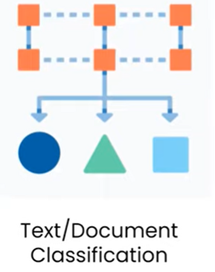

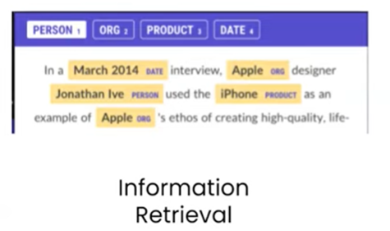

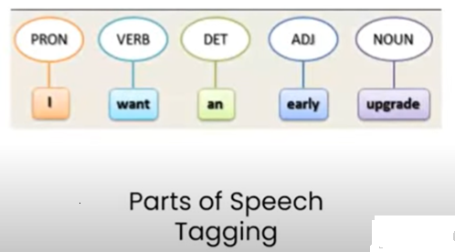
Common NLP Tasks

Slide 23
Common NLP Tasks
Text or Document Classification: This involves categorizing a large text or document into specific categories. For example, if you have a lengthy document, you can classify it into categories like "Sports" or "Politics.“
Sentiment Analysis: This is widely used in e-commerce and social media. By analyzing user reviews, companies can determine how people feel about a product or a movie.
For instance, if a product has one crore reviews, instead of reading each review individually; sentiment analysis can quickly tell the percentage of positive reviews, making it easier to gauge public opinion.
Information Retrieval: This task involves extracting specific information from a text, such as names, dates, product details, or event information.
Search engines use information retrieval to provide relevant results based on user queries. when we study named entity recognition in future where We will do exactly the same thing

Slide 24
Common NLP Tasks
Parts of Speech Tagging: This is a crucial text processing step where words in a text are tagged with their parts of speech, such as verbs, nouns, or adjectives.
POS tagging helps understand the context and meaning of each word in a sentence.
When building a chatbot or a question-answering system, understanding the question or text word by word is crucial to grasping the meaning of the sentence.
In such analysis, part-of-speech (POS) tagging is very helpful and thus an essential text preprocessing step.
Language Detection and Machine Translation: Tools like Google Translate allow you to input text in one language and translate it into another.
Language detection is NLP task that identifies the language of the input text, while machine translation converts it into the desired language and it is achieved through deep learning.

